Slide 1
Mining and Analyzing Social Media: Part 2
Dave King
HICSS 47 - January 2014

Slide 2
Agenda: Part 2
Introduction to Social Network Analysis Metrics
Degrees of Separation
Hooray for Bollywood
Standard Measures
Centrality
Cohesion
Levels of Social Network Analysis
Facebook & Egocentric Analysis
Searching for Cohesive Subgroups

Slide 3

Social Network Analysis
Analyzing Social Networks – The World of Metrics
Social scientists, physicists, computer scientists, and mathematicians have collaborated to create theories and algorithms for calculating novel measurements of social networks and the people and things that populate them. These quantitative network metrics allow analysts to systematically dissect the social world, creating a basis on which to compare networks, track changes in a network over time, and determine the relative position of individuals and clusters within a network.

Slide 4
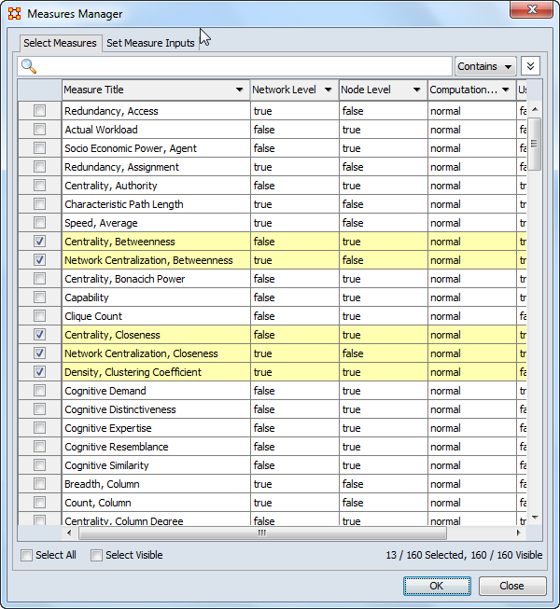
Social Network Analysis
Wide Variety of Metrics Available

Slide 5
Social Network Analysis
Best Known Social Metric
6

Slide 6
Social Network Analysis
6 Degrees of Separation
A fascinating game grew out of this discussion. One of us suggested performing the following experiment to prove that the population of the Earth is closer together now than they have ever been before. We should select any person from the 1.5 billion inhabitants of the Earth—anyone, anywhere at all. He bet us that, using no more than five individuals, one of whom is a personal acquaintance, he could contact the selected individual using nothing except the network of personal acquaintances.
Frigyes Karinthy , Chains, 1929
P1
I1
I2
I3
I4
I5
P2
Degrees of separation ~ Average Path Length ~ Distance

Slide 7
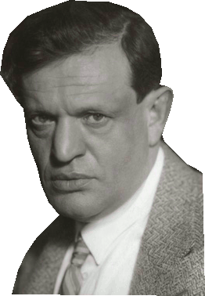

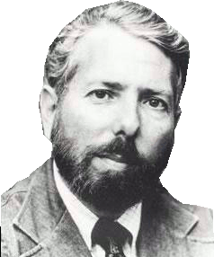
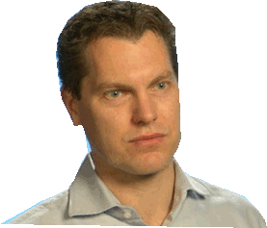

Social Network Analysis
Why the notoriety?
Frigyes Karinthy
1929
John Guare
1990
Stanley Milgram
1967
Duncan Watts
1998
Six Degrees of Kevin Bacon (1994)

Slide 8
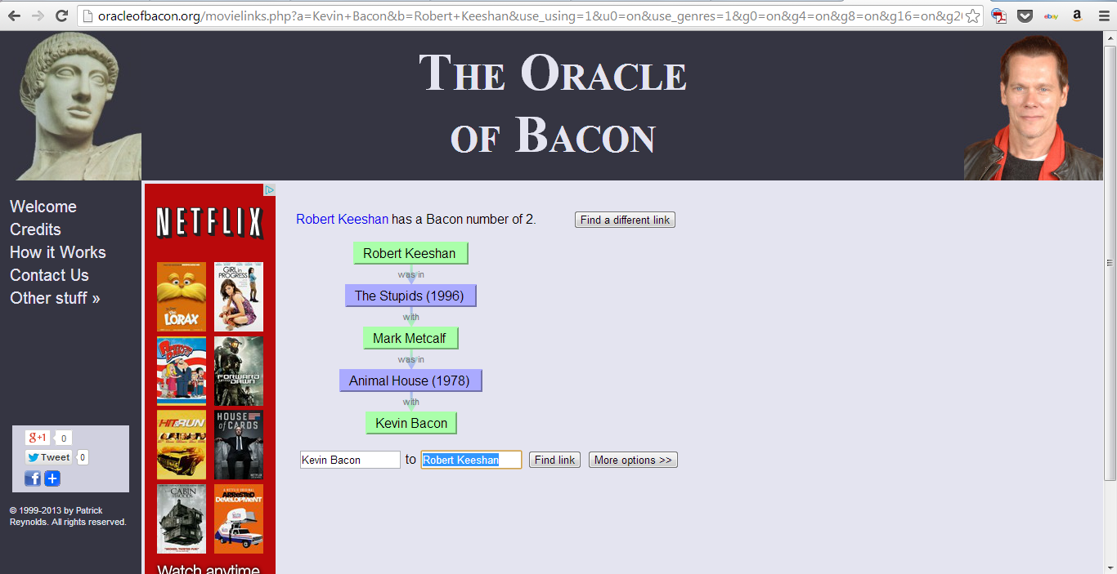
Social Networks
The Oracle of Bacon

Slide 9
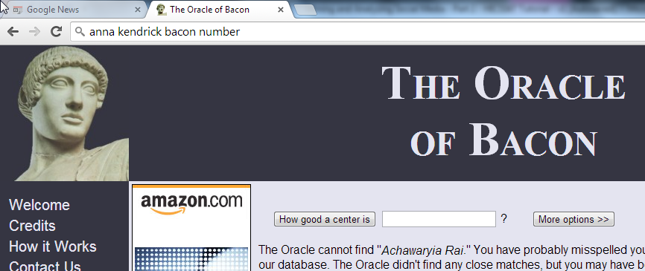

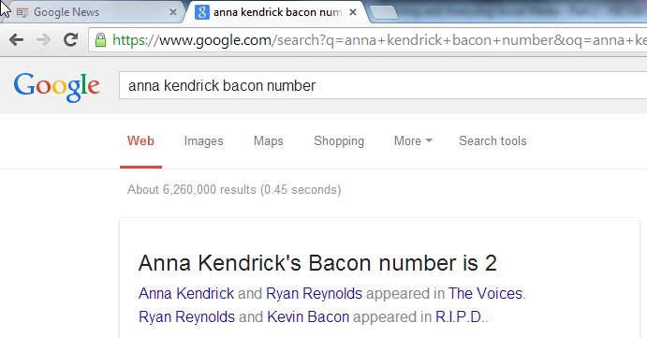
Social Network Analysis
Oracle of Bacon gone mainstream

Slide 10
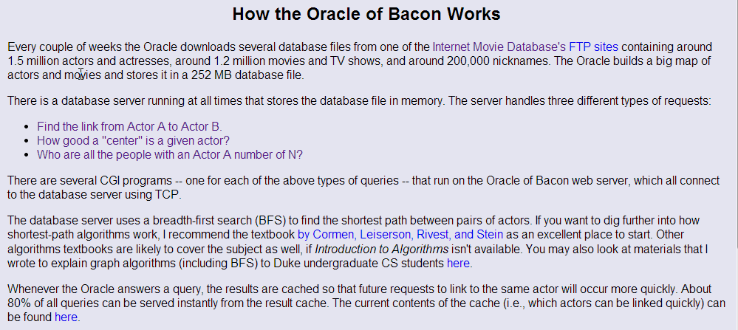
Social Network Analysis
How the Oracle of Bacon Works

Slide 11
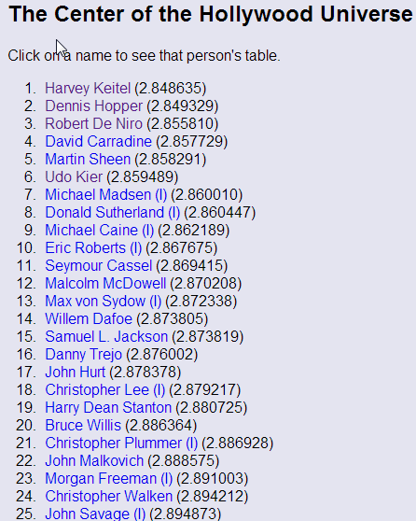
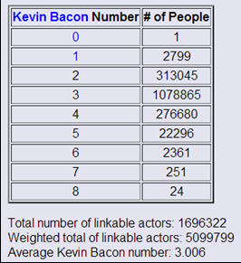
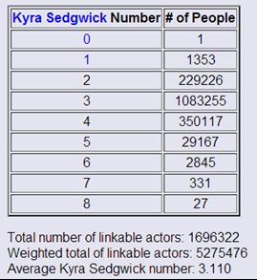
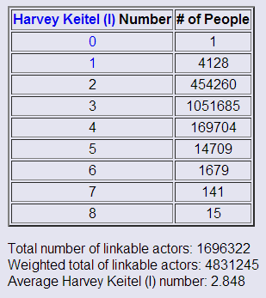
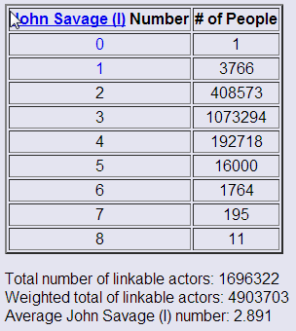
Social Network Analysis
Center of the Hollywood Universe

Slide 12




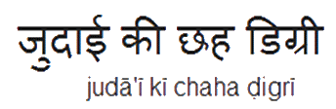
Social Network Analysis
of Bachchan
Aishwarya Rai
Bachchan
Amitabh Bachchan
Abhishek Bachchan

Slide 13
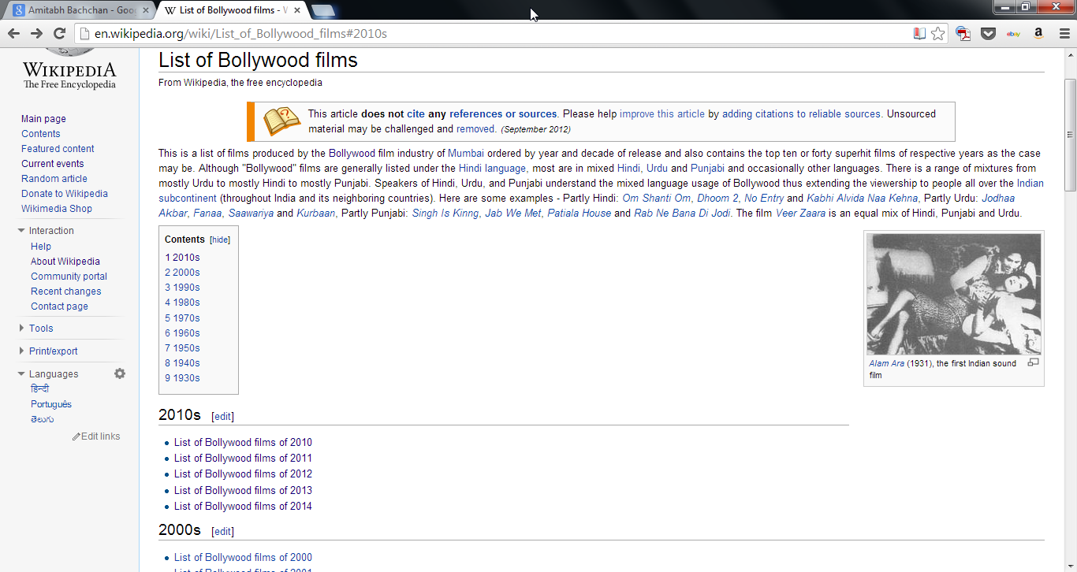
Social Network Analysis
There’s a new game in town

Slide 14
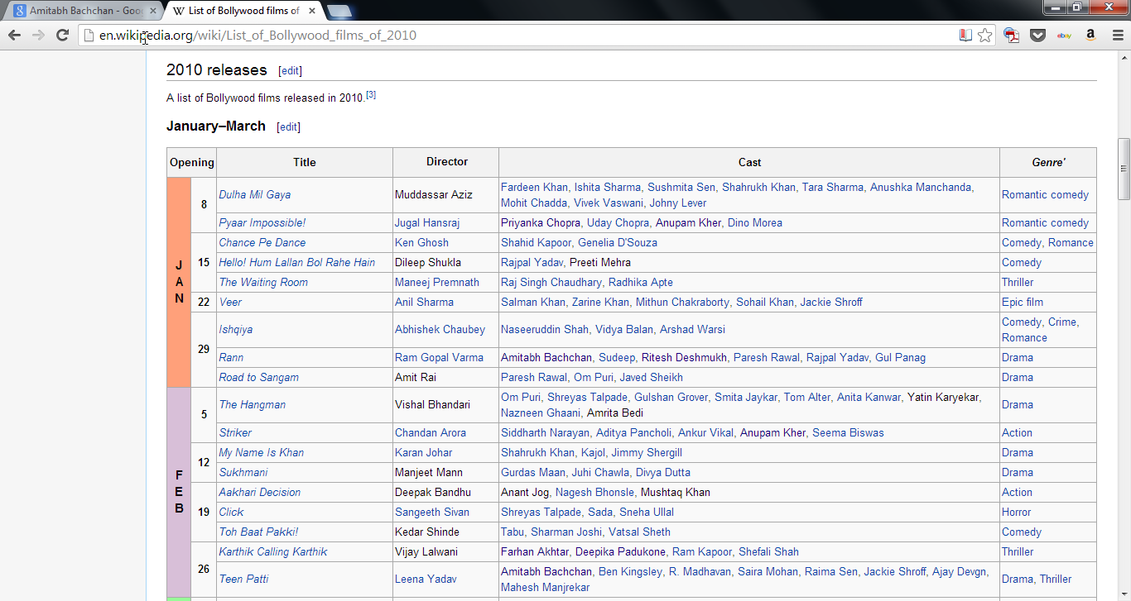
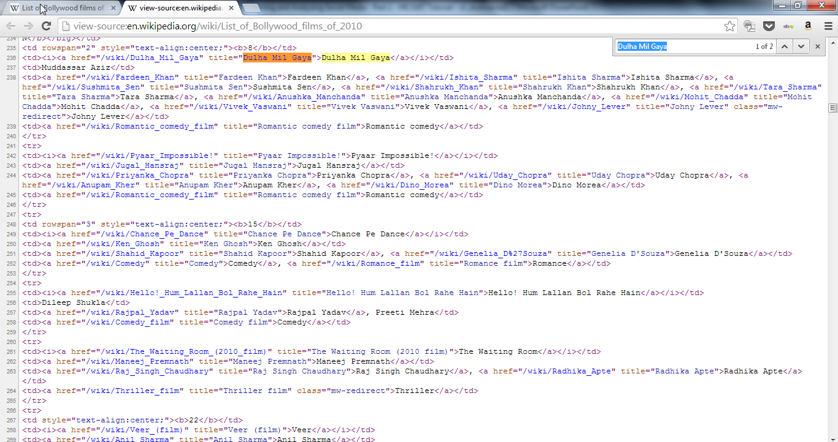
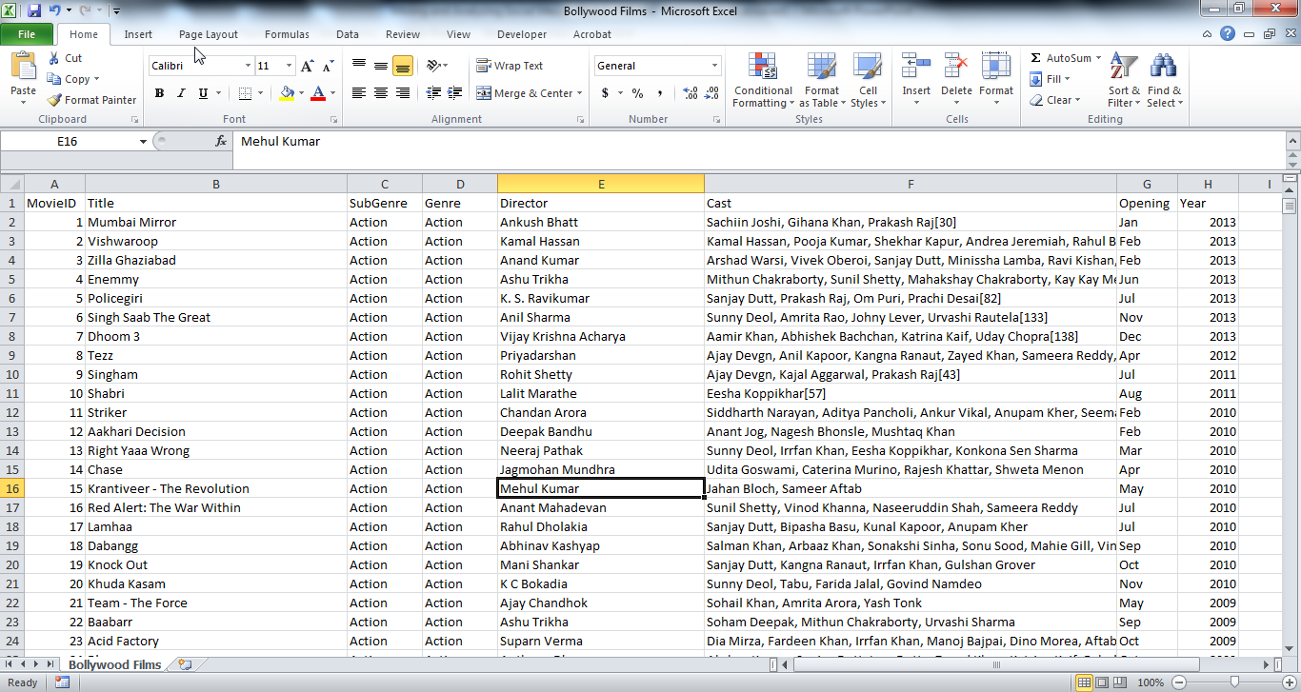
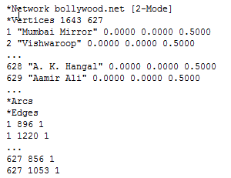
Social Network Analysis
The Center of Bollywood
Wikipedia Web Page
HTML- Page Source
Relational DB – 627 Movies – 1061 Actors
(2010-2013)
Pajek .NET File

Slide 15
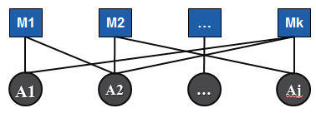
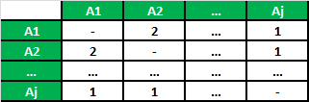
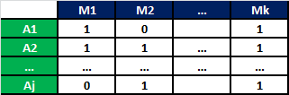
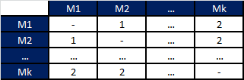
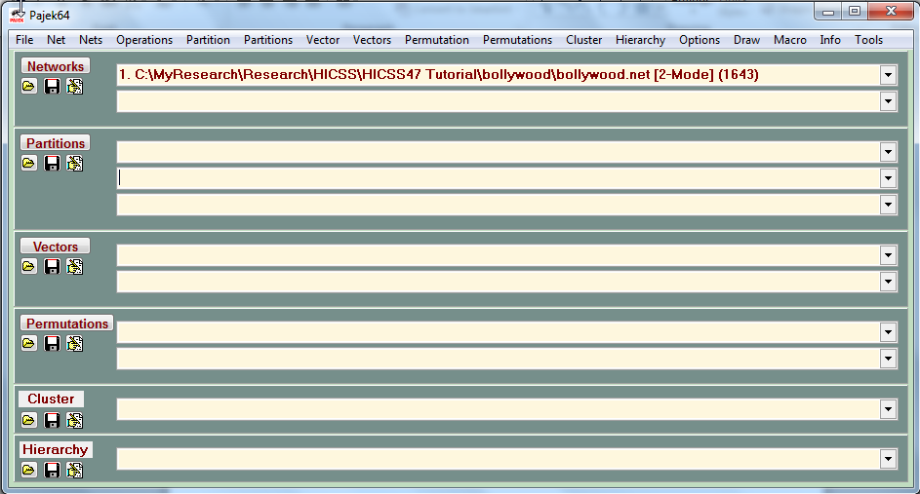
Social Network Analysis
Bipartite Network – Movies and Actors
Pajek .NET File

Slide 16
Social Network Analysis
Analyzing Bollywood

Slide 17

Social Networks
Rules of Networks
RULE 1: WE SHAPE OUR NETWORK
RULE 2: OUR NETWORK SHAPES US
RULE 3: OUR FRIENDS AFFECT US
RULE 4: OUR FRIENDS’ FRIENDS’ FRIENDS AFFECT US
RULE 5: THE NETWORK HAS A LIFE OF ITS OWN

Slide 18
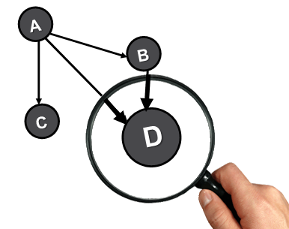

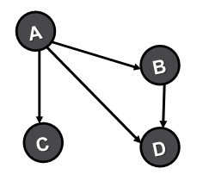
Social Network Analysis
Bifurcated Methodology
Local
Measures
Global
Measures

Slide 19
Social Network Analysis
Walks and Paths
Undirected
Sample Walks
((C,A),(A,D))
((C,A),(A,B),(B,D))
((C,A),(A,D),(D,A),(A,D))
Two points may be directly connected or indirectly connected thru a sequence of lines called a walk.
If points and lines are distinct it’s a path.
The length of a path is the number of edges (or lines) that make it up.
The shortest length is called the distance or geodesic.
A
B
Sample Paths
((C,A),(A,D))
((C,A),(A,B),(B,D))
C
D
Directed
Sample Walks
((C,A),(A,D))
((C,A),(A,B),(B,D))
A
B
Sample Paths
((C,A),(A,D))
((C,A),(A,B),(B,D))
C
D

Slide 20
Social Network Analysis
Centrality – Who is most influential?

Slide 21
Social Network Analysis
Cohesion – How well connected?

Slide 22
Social Network Analysis
Generic Example for
B
E
For each of the nodes what is it’s
Degree Centrality
Betweenness Centrality
Closeness Centrality
Eigenvector Centrality
For the entire network what is it’s
Degree Centralization
Betweenness Centralization
Closeness Centralization
Eigenvector Centralization
A
D
G
C
F
H
R
I
N
P
J
O
K
L
M
Q
S

Slide 23

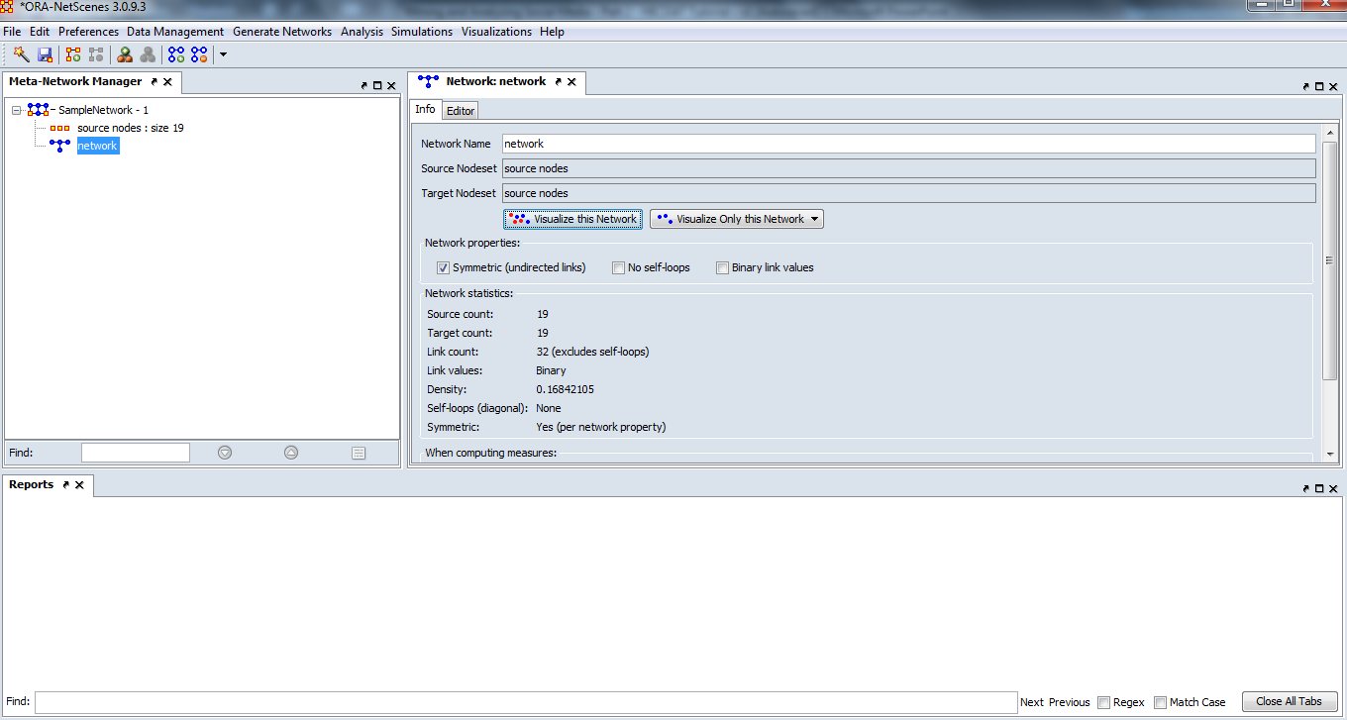
Social Network Analysis
Visualizing and Analyzing with ORA

Slide 24
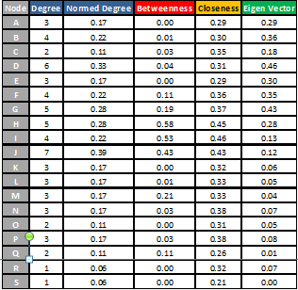
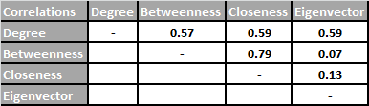
Social Network Analysis
Centrality – Who is most important?
B
E
Eigenvector
A
D
G
C
F
Betweenness
H
Closeness
R
I
N
P
Degree
J
O
K
L
M
Q
S

Slide 25
Social Network Analysis
Cohesion – How well connected?
B
E
A
D
G
C
F
H
R
I
N
P
J
O
K
L
M
Q
S

Slide 26
Social Network Analysis
The World of Facebook
Active Users
Mobile Users
Logon Daily
1.2B
18%
.9B
45%
.7B
25%
Likes Daily
Pieces of Content
Shared Daily
New Profiles
4.5B
67%
5/second
4.8B
94%
Photo Uploads
Of Total Web
Page Views
Avg Time
Per Visit
300M/day
1/5 on FB
20 minutes
Sex Ratio
Europe
Age 24-34
53%F/47%M
.2B Users
30% of users

Slide 27
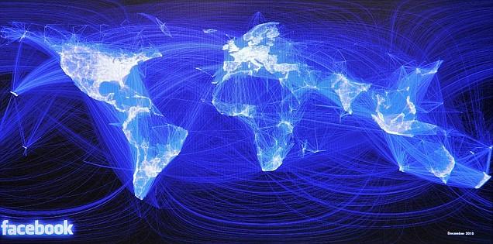
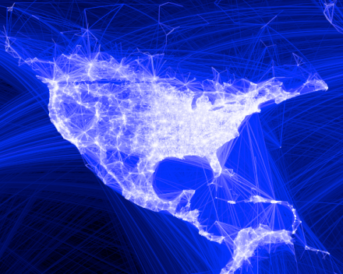
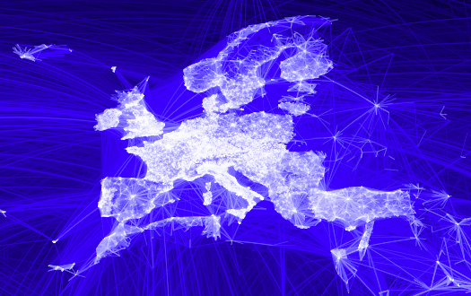
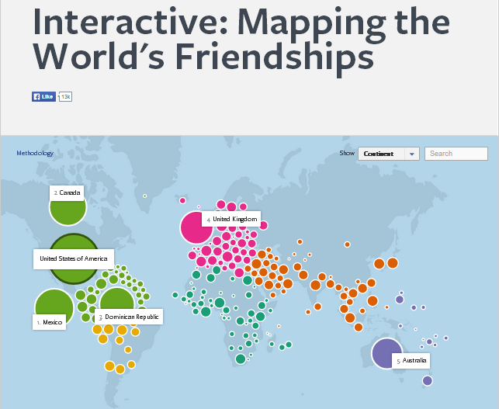

Social Network Analysis
Facebook in the World
facebookstories.com/stories/1574/
#color=language-official&story=1&country=SA

Slide 28
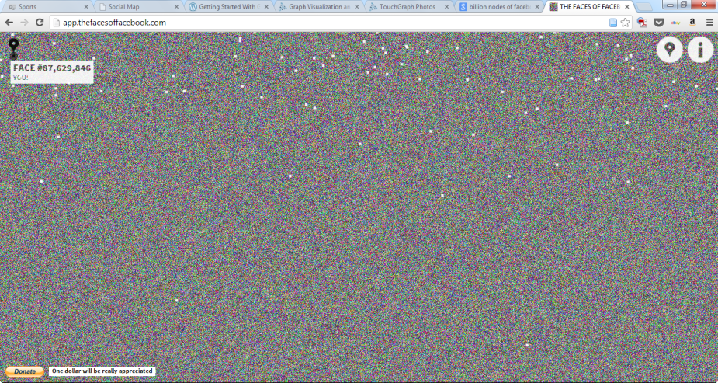
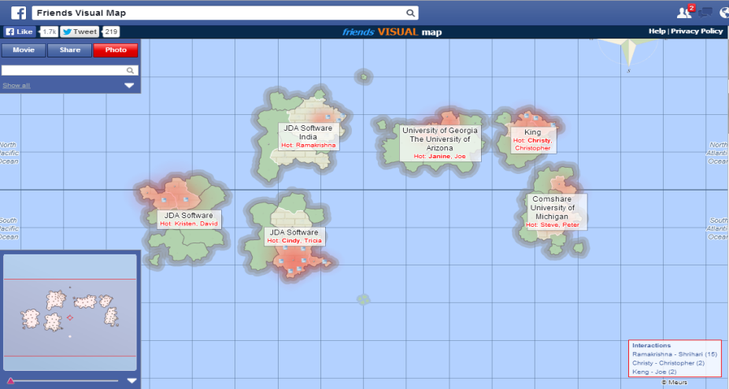
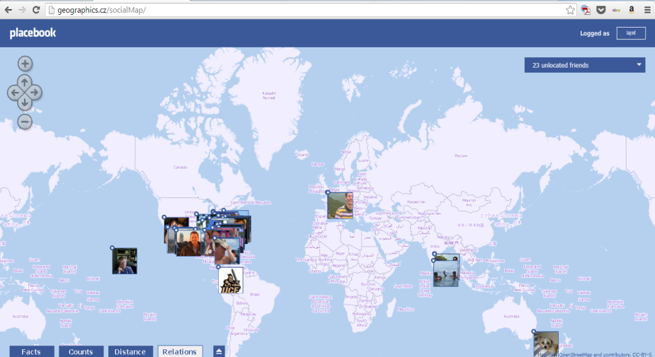
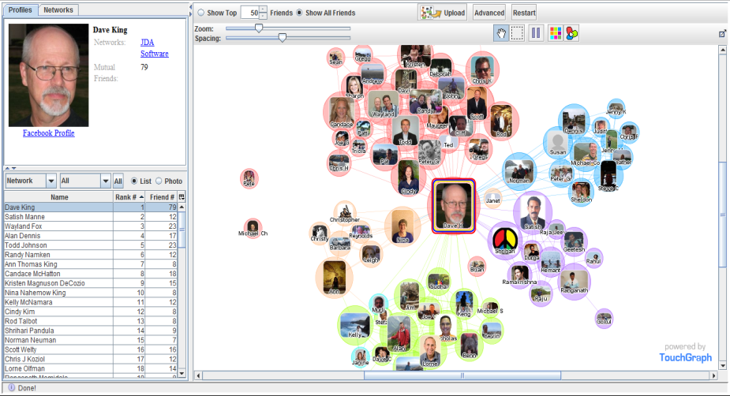
Social Network Analysis
Your World of Facebook
app.thefacesoffacebook.com
apps.facebook.com/challenger_meurs/
?fb_source=appcenter&fb_appcenter=1
Geographical.cz/socialMap/
apps.facebook.com/touchgraph/

Slide 29
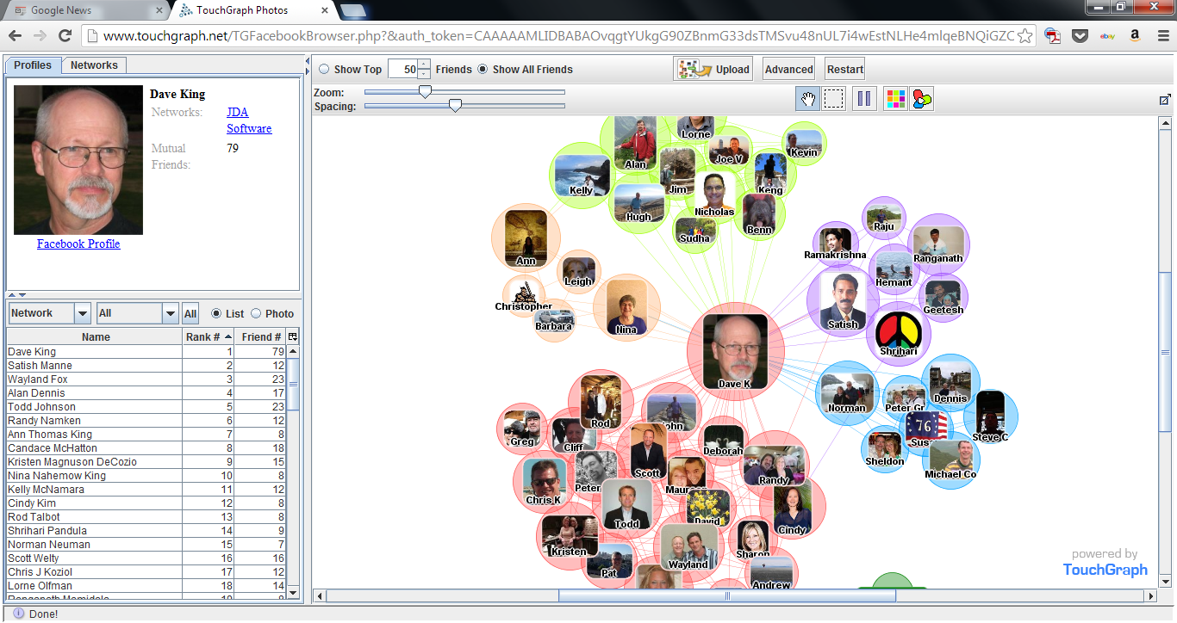
Social Network Analysis
Egocentric Network – Facebook Example

Slide 30
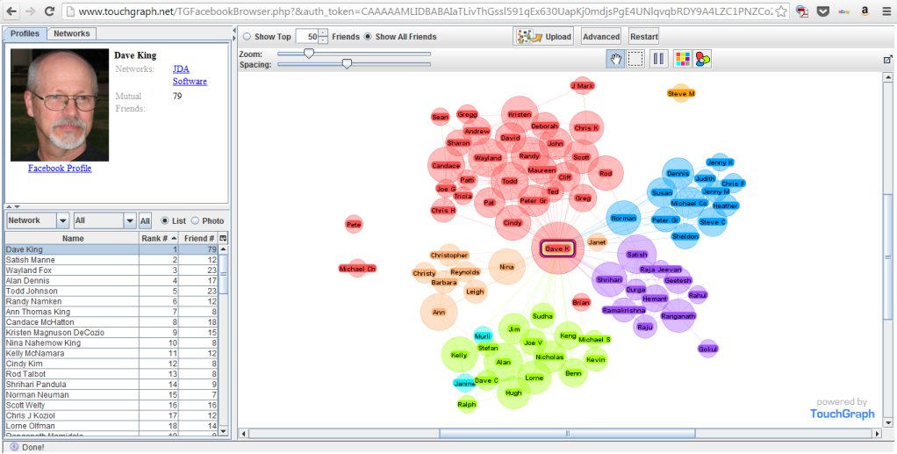
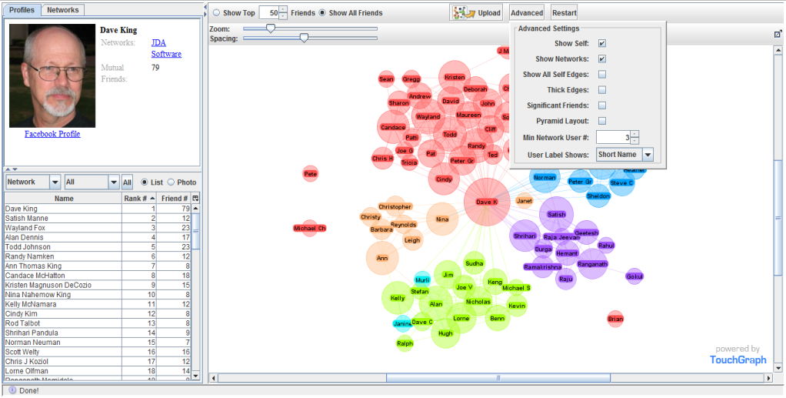
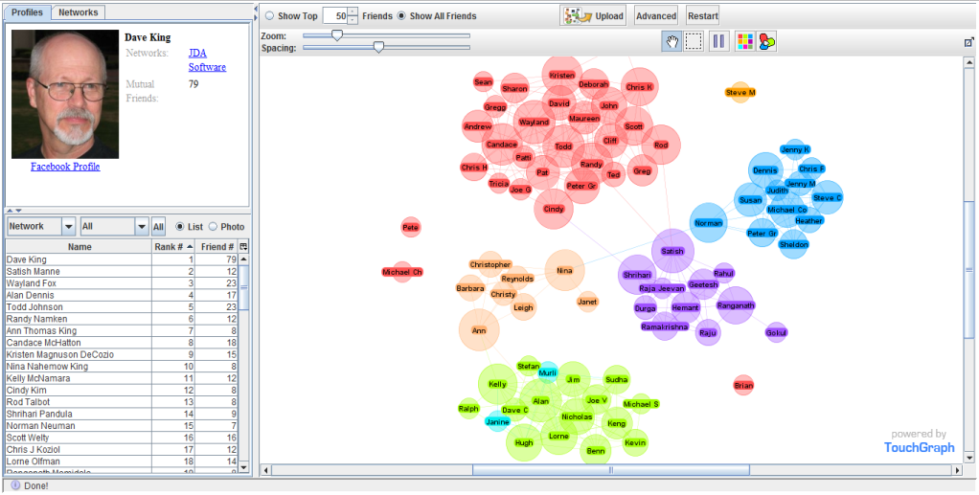
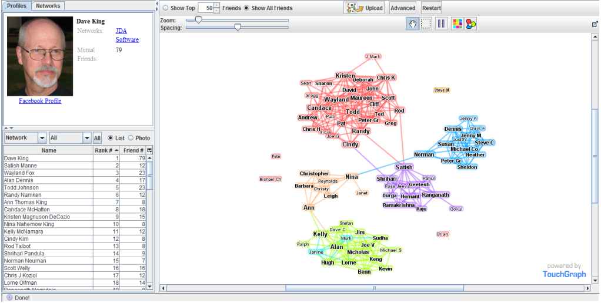
Social Network Analysis
Egocentric Network – Facebook Example

Slide 31
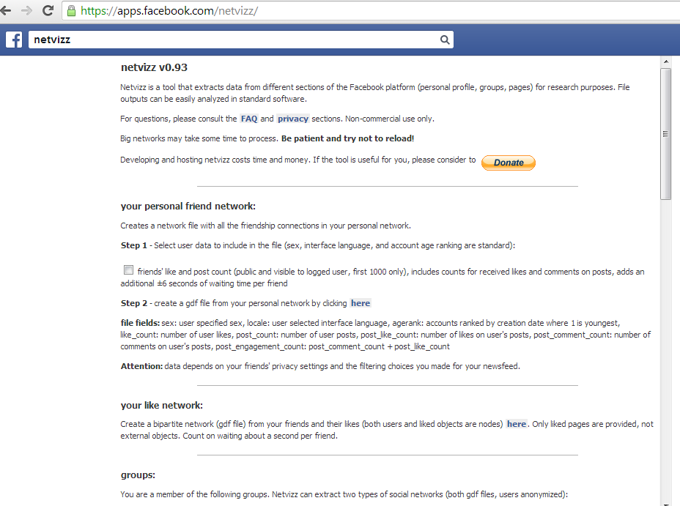
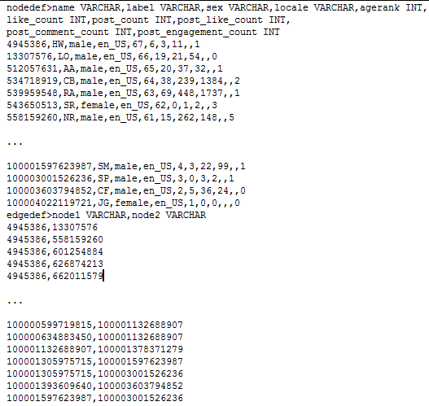
Social Network Analysis
Egocentric Network – Facebook Example
Netvizz v0.93
.gdf (GUESS) file format
One simple way to generate SNA data from Facebook

Slide 32
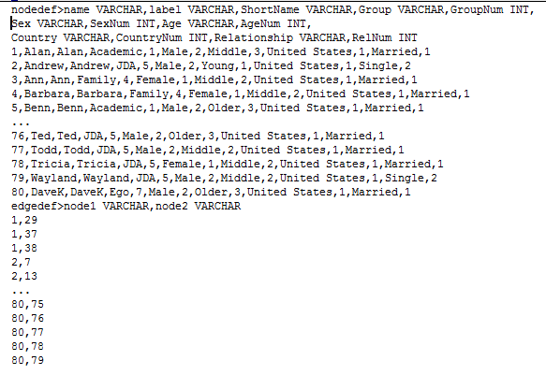
Social Network
Egocentric Network – Facebook Example
Cleansed-Augmented Guess .GDF File used for analysis
guess.wikispot.org/The_GUESS_.gdf_format

Slide 33
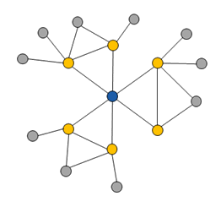
Social Network Analysis
Egocentric Networks – by Degree
1.0
1.5
2.0
Ego
(Ego’s) Alter
Alter’s Alter

Slide 34
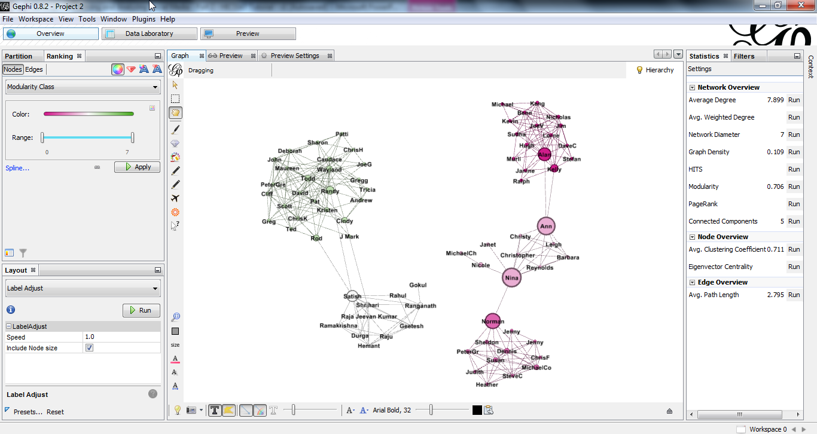
Social Network Analysis
Egocentric Network – Facebook Example

Slide 35



Social Network Analysis
Egocentric Network – Facebook Example
Getting Started With The Gephi
Network Visualisation App
– My Facebook Network, Part I
blog.ouseful.info/2010/04/16
/getting-started-with-gephi-network-visualisation-app-my-
facebook-network-part-i/

Slide 36
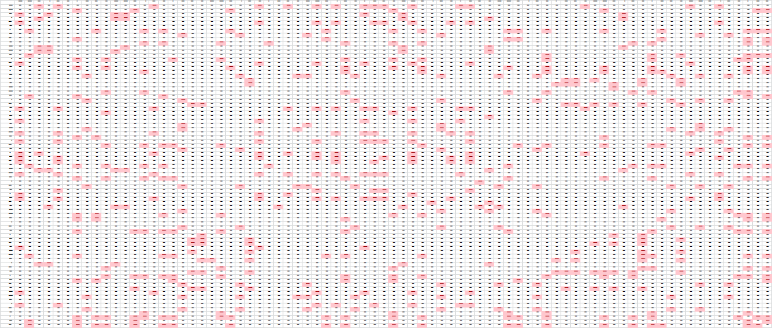
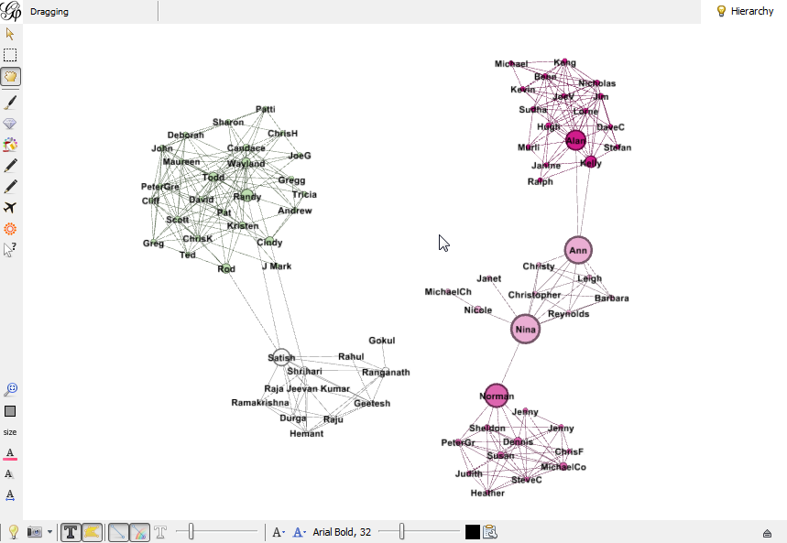
Social Network Analysis
Egocentric Network – Facebook Example
Matrix Representation
Graph Representation
PL = N(N-1)/2 = 3081
Ego Density = L/PL = 312/3081 =.10

Slide 37
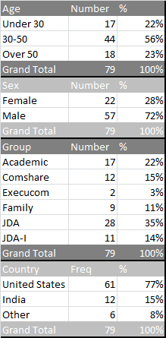







Social Network Analysis
Egocentric Network – Facebook Example
(Avg 7.9)
(Avg 32.0)
(Avg .26)
(Avg 2.7)
(Avg 7.9)
(Avg .66)

Slide 38


Social Network Analysis
Another Analytical Alternative - NodeXL

Slide 39


Social Network Analysis
Facebook Analysis
The emergence of online social networking services over the past decade has revolutionized how social scientists study the structure of human … previously invisible social structures are being captured at tremendous scale and with unprecedented detail.
Accessed within 28 days of May ’11
At least one friend
Over 13 years of age

Slide 40
Social Network Analysis
Nearly fully connected, with 99.91% of individuals belonging to a single large connected component
Confirm ‘six degrees of separation’ phenomenon on a global scale. Second, by studying
While the Facebook graph as a whole is clearly sparse, the graph neighborhoods of users contain surprisingly dense
Clear degree assortativity.
Strong impact of age on friendship preferences as well as a globally modular community structure driven by nationality, but no gender homophily.

Slide 41




Social Network Analysis
Facebook Analysis
14% for 100
Assortativity
P(F|F) = .52
P(F|M) = .51

Slide 42



Social Network Analysis
Facebook Analysis
Average
4.7
Average
4.3
World 92% 99.6%
US 96% 99.7%

Slide 43
Social Network Analysis
Looking for Cohesive Subgroups

Slide 44

Sociology
Cohesive Subgroups
Many individuals have large clusters of friends corresponding to well-defined foci of interaction in their lives, such as their cluster of co-workers or the cluster of people with whom they attended college. Since many people within these clusters know each other, the clusters contain links of very high embeddedness, even though they do not necessarily correspond to particularly strong ties.

Slide 45
Social Network Analysis
Cohesive Subgroups
B
E
In a complete graph all the nodes are adjacent to one another
A network is connected if every two nodes in the network are connected by some path in the network
A directed graph is strongly connected if and only if for every pair of vertices x , y, there is a directed path from x to y and a directed path from y to x between them. It is weakly connected if there is at least an undirected path for every pair of vertices.
A graph G has components G1 and G2 if no (undirected) path exists between any node in G1 to any node of G2 (component is an isolated subgraph)
A link is a bridge in a network if it’s removal increases the number of components in the network
A
D
G
C
F
H
R
I
N
P
J
O
K
L
M
Q
S

Slide 46
Social Network Analysis
Cohesive Subgroups
B
E
A clique is a maximal complete subnetwork containing three vertices or more.
n-clique is a maximal subnetwork in which the maximum path length for connection is “n” (e.g. 2-clique has nodes connected by paths of 1 or 2 lengths).
A k-core is a maximal subnetwork in which each vertex has at least degree k within the subnetwork (e.g. 3-core)
Girvan-Newman Algorithm breaks complex networks into “communities” by removing edges (betweenness) resulting in fragmentation
A
D
G
C
F
H
R
I
N
P
J
O
K
L
M
Q
S

Slide 47

Social Network Analysis

Slide 48
Social Network Analysis
It’s a Small World after all, or is it?
6.0 vs. 4.7

